Slide 1

Data Analysis Associate
Accredited by

Slide 2
Comparison Analysis

Slide 3
Comparison Analysis
Comparison analysis involves comparing different variables, groups, or scenarios to identify similarities, differences, patterns, and trends.
Eg. Compare sales and profit across all the regions.

Slide 4
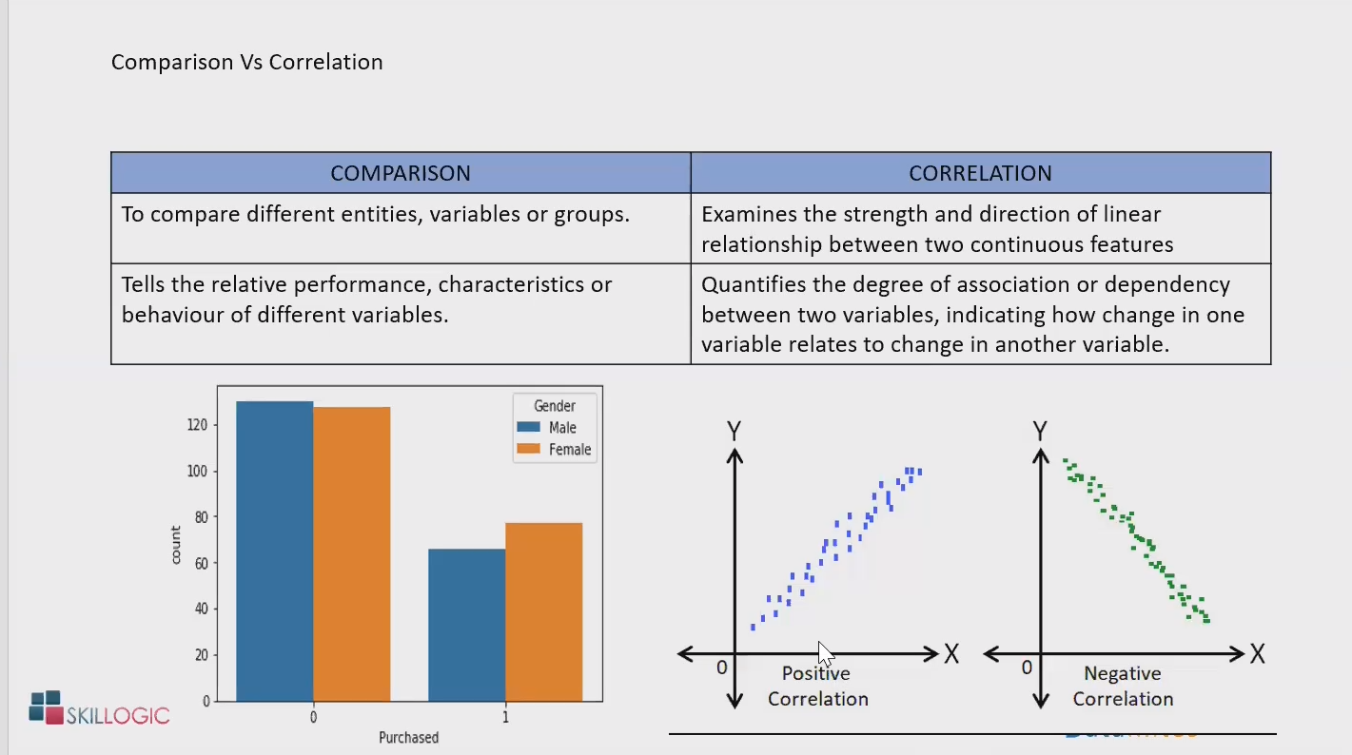

Slide 5
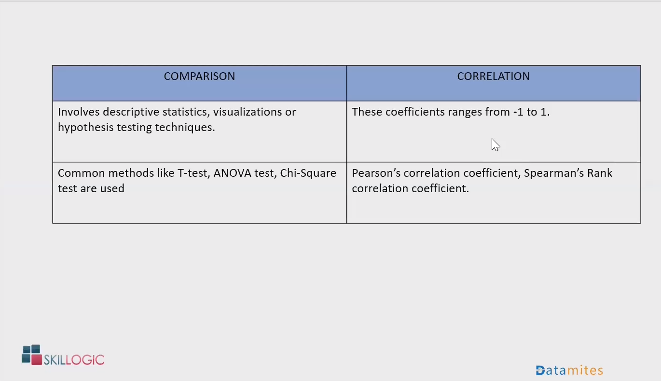

Slide 6
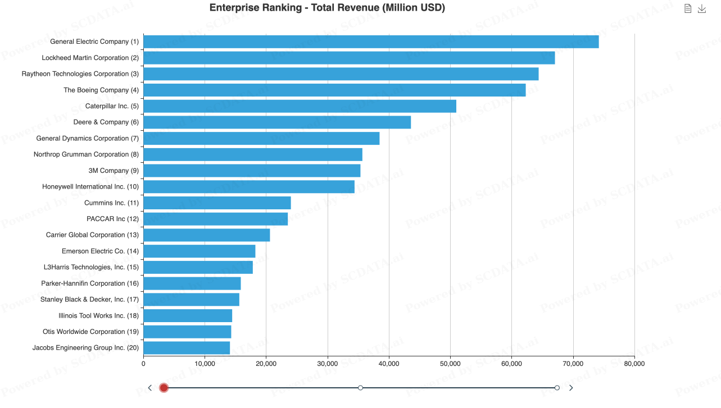
Ranking Analysis
Process of evaluating and analyzing the rankings of items, entities or data, based on certain criteria or attributes.
Eg. Find the top 5 products in terms of Sales.

Slide 7
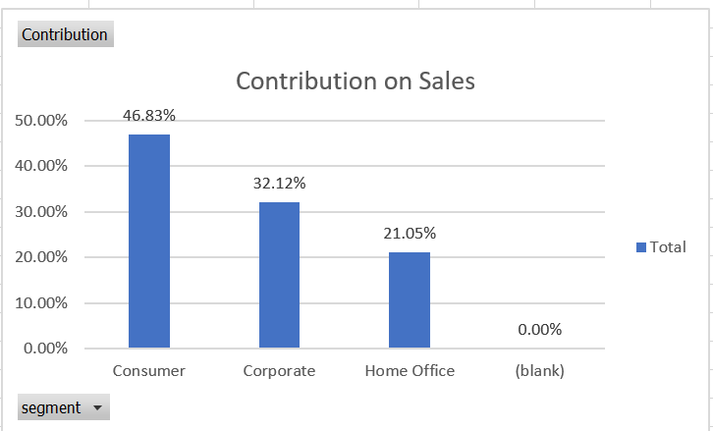
Contribution Analysis
Contribution analysis is a powerful tool that helps businesses and organizations to analyze the contribution of various factors towards a particular outcome.
Eg. Analyze the contribution of categories towards Sales, Revenue, etc

Slide 8
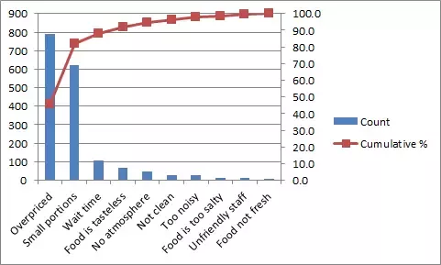
Pareto Analysis
Pareto analysis, also known as the 80/20 rule, is a management tool used to identify the most significant factors or causes that contribute to a particular outcome. In Pareto analysis, it is assumed that 80% of the effects are caused by 20% of the factors.
Restaurant

Slide 9
Also called an 80-20 rule, 80% of the problems are caused by 20% of facts whether if you look into profits, customer complaints, technical issues, product defects, etc.
It statistically separates a limited number of input factors that have a greater impact on an outcome
It is a powerful quality and decision-making tool.
It organizes and displays information to show the relative importance of various problems or causes of problems.

Slide 10
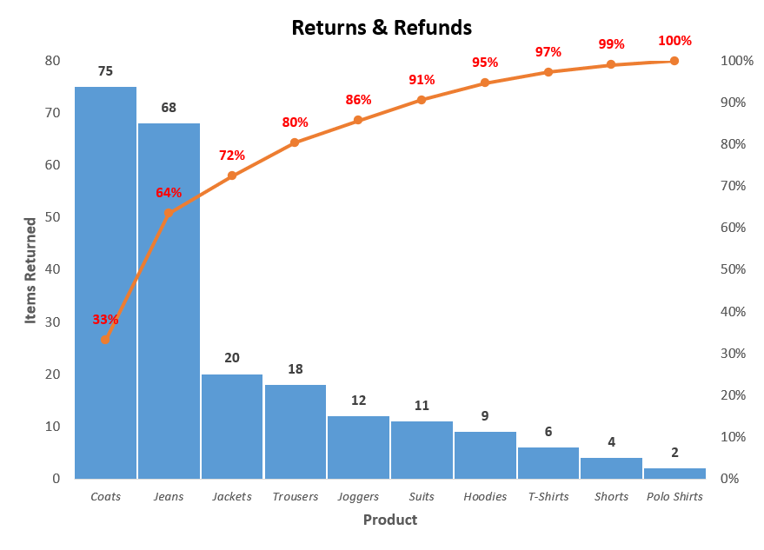
Returns & Refunds

Slide 11
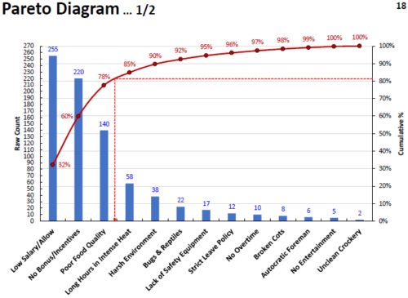
Attrition

Slide 12
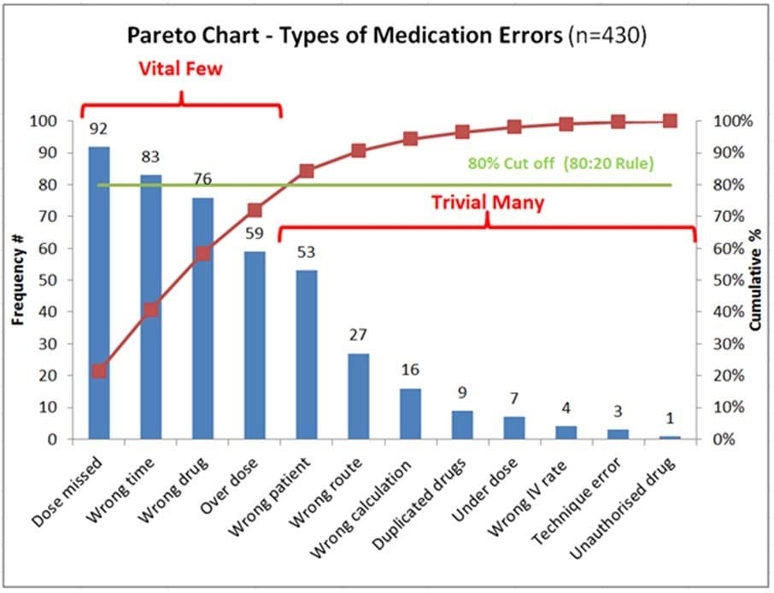
Medication Errors

Slide 13
Interactive Dashboards
Interactive dashboards in Excel are a powerful way to present and analyze data. They allow users to explore and analyze data through interactive charts, tables, and visualizations.
It is a Data Management tool which comes with various interactive features where users can explore the data on a deeper level.
- Prepare your data.
- Create your dashboard with charts, tables or visualizations.
- Add interactivity using slicer, filters, pivot table etc
- Customize your dashboard
With interactivity, you can create a powerful and effective dashboard that will help you make better decisions based on your data.

Slide 14
Time Series Data
Time series data is a sequence of data points that measure some variable over ordered period of time. It helps to understand and forecast data patterns. It is important to look for the pattern or components in a Time Series data such as Trend, Seasonality etc.
Examples: Weather Forecasting, Sales Trends, Data captured in CCTV, Stock price, etc

Slide 15
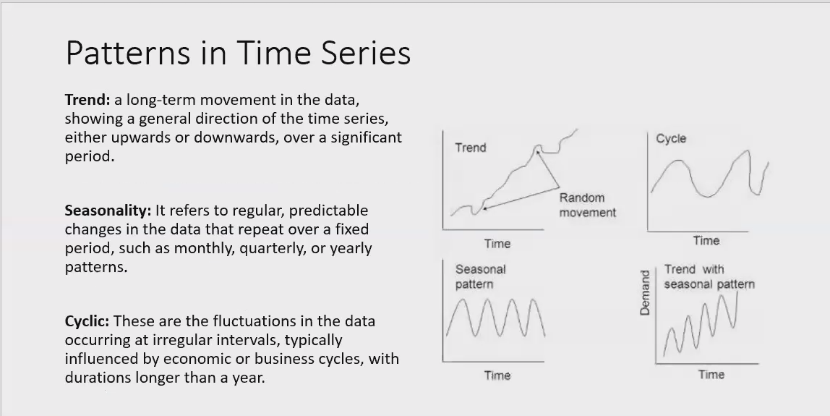

Slide 16
Trend Analysis
Trend is a pattern in data that shows the movement of a series to relatively higher or lower values over a long period of time. In other words, a trend is observed when there is an increasing or decreasing slope in the time series.
Hands-on – Trend Analysis for a Time Series Data.
Line Chart:
Show how a continuous variable changes over time.

Slide 17
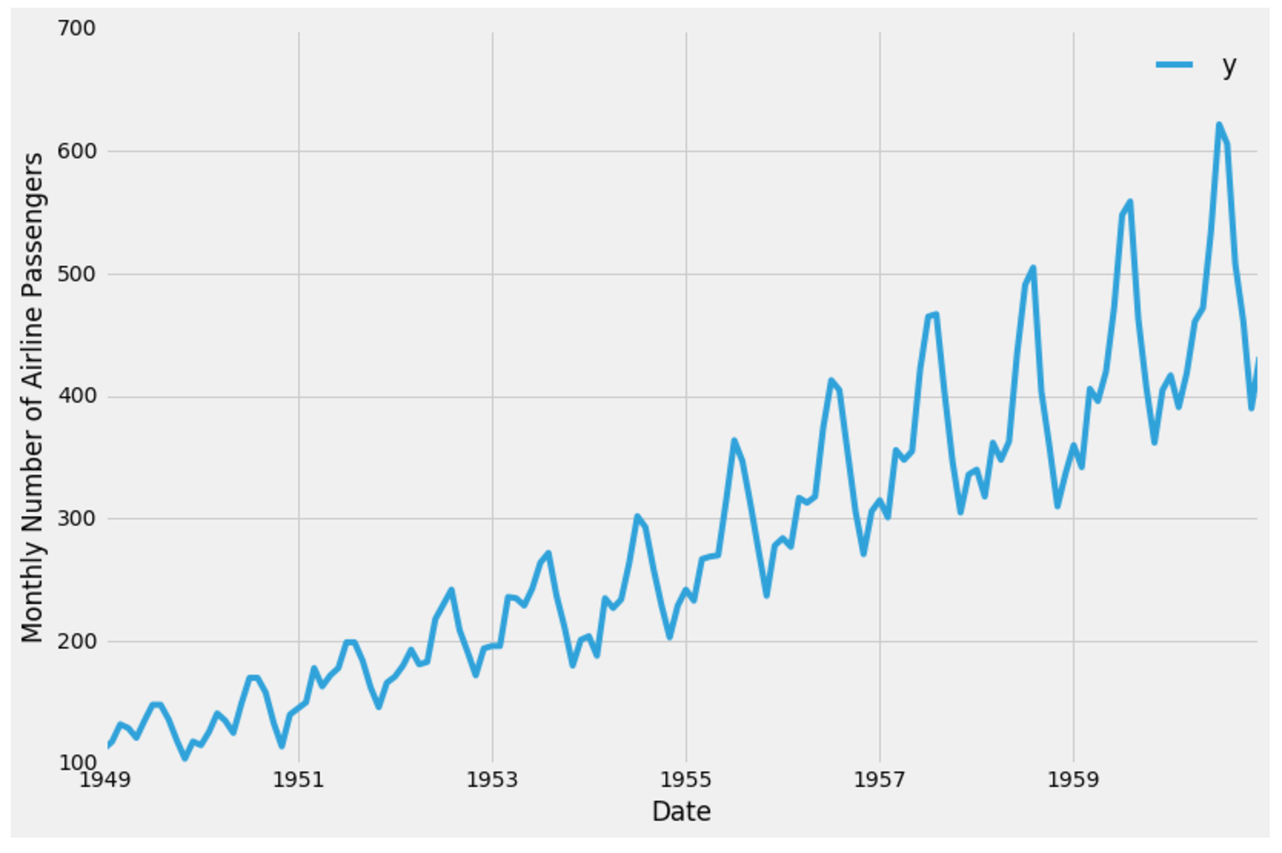
Types of Trend
Upward trend:
Time Series Analysis shows a general pattern that is upward then it is Upward trend.
Downward trend:
Time Series Analysis shows a pattern that is downward then it is Downward trend.
Horizontal or Stationary trend:
If no pattern is observed then it is called a Horizontal or stationary trend.

Slide 18
Break Even Analysis
Decision Modeling

Slide 19
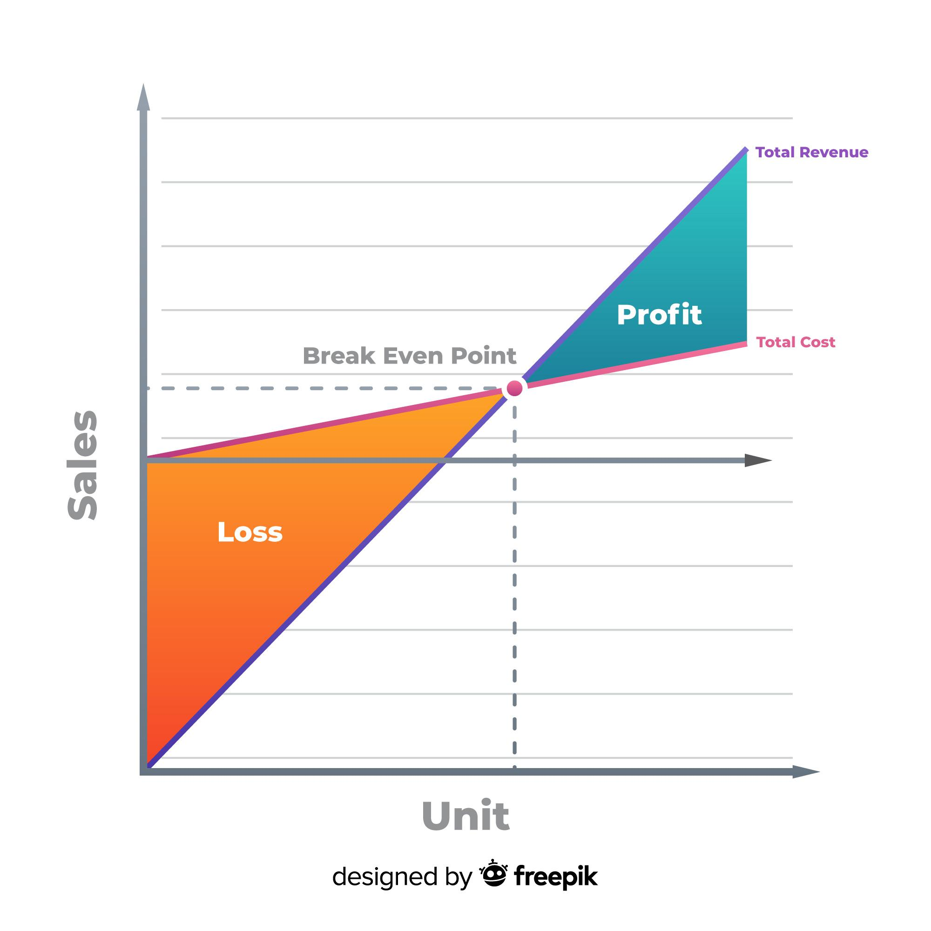
What is Break-even?
Primarily, any venture begun by a firm requires certain capital costs.
It is expected that the business recovers this initial capital through earnings over a period of time.
The position of no profit - no loss is termed as Break-Even for a venture.

Slide 20
Decision Modeling
Software Purchase or In-House?
The business decision needs to be made to make or buy a software product.
Software development project costs $200,000 and maintenance of the software infrastructure costs $30 per user per annum.
Buying a SAAS product directly from a software vendor. This has no development or upfront costs, and the software vendor charges $250 per user per annum.
Decision is to choose more economic model based on the number of users.
Assume that development cost of $200k is required to maintain and add new feature every year.

Slide 21
Break Even Decision Model
Total Cost of Development = $200,000 + $30 x Users
Total Cost of SAAS software = $250 x Users
Breakeven Point:
Can get break even point by equating above equations
$200,000 + $30 x Users = $250 x Users
220xusers = 200,000 🡺 about 909 users.
This means at 909 users both costs are same. So, if number of users are more than 909, then we develop software otherwise buying SAAS software is better.
General Formula
F + VQ = CQ
Q = F/(C - V)

Slide 22



Refer & Earn
up to ₹ 5,000/- per referral
End of the Module
Contact care@datamites.com for any queries

